Slide 1
CSE 2215: Data Structure and Algorithms-II
Minimum Spanning Tree

Slide 2
Things You Will Learn
What is a spanning tree?
What is a minimum spanning tree (MST)?
Optimal Substructure Property in the MST problem
Prim’s Algorithm
Simulation
Algorithm
Cost Analysis
Kruskal’s Algorithm
Simulation
Algorithm
Cost Analysis

Slide 3
Spanning Tree
A spanning tree is a subset of Graph G, which has all the vertices covered with minimum possible number of edges. Hence, a spanning tree does not have cycles and it cannot be disconnected. By this definition, we can draw a conclusion that every connected and undirected Graph G has at least one spanning tree.
If there are n vertices in the graph, then each spanning tree has n − 1 edges.

Slide 4
Spanning Tree
Let us use this weighted graph as an example
A
6
4
H
5
B
9
C
14
2
10
G
E
15
D
3
8
F

Slide 5
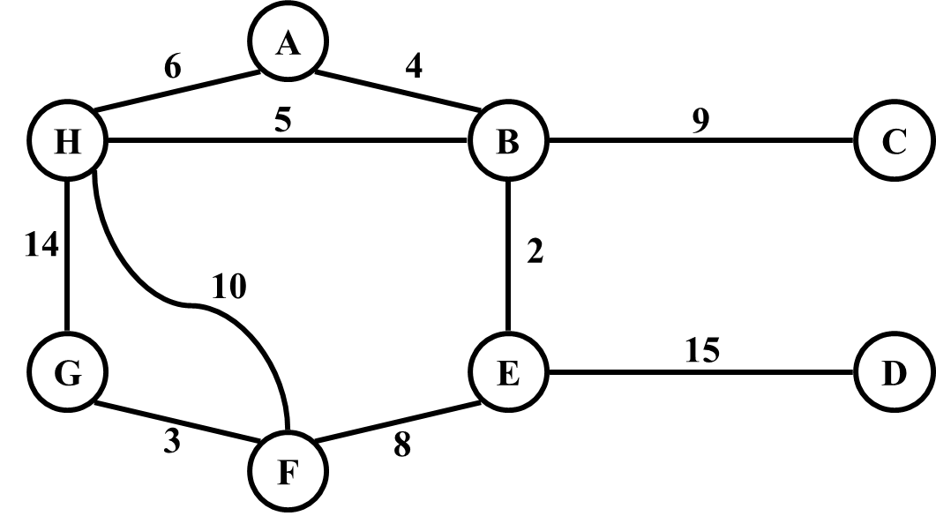
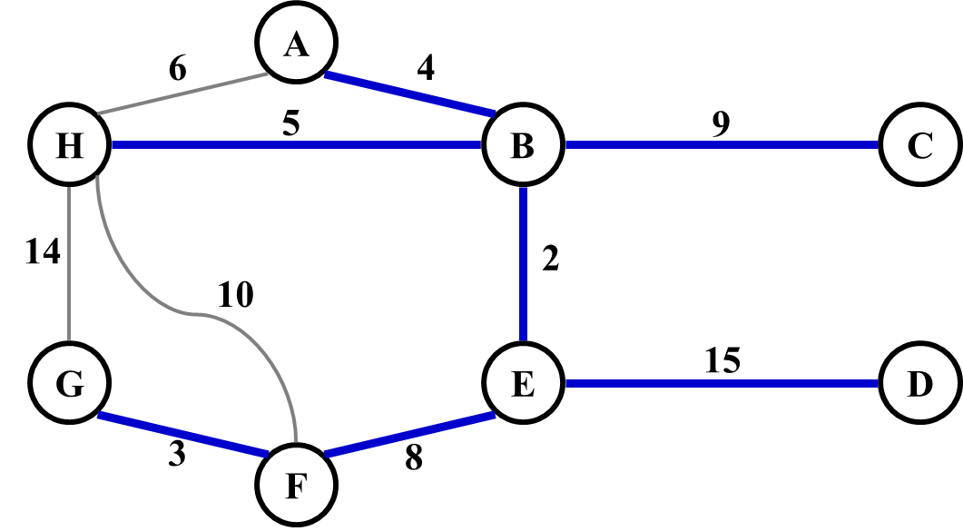
Minimum Spanning Tree

Slide 6
Optimal Substructure Property in MST
The problem of finding MSTs satisfies the optimal substructure property
An optimal minimum spanning tree is composed of optimal minimum spanning subtrees
6
4
5
9
14
2
10
15
3
8

Slide 7
Minimum Spanning Tree
MSTs satisfy the optimal substructure property: an optimal minimum spanning tree is composed of optimal minimum spanning subtrees
Let T be an MST of G with an edge (u, v) in the middle
Removing (u, v) partitions T into two trees T₁ and T₂
Claim: T₁ is an MST of G₁ = (V₁,E₁), and T₂ is an MST of G₂ = (V₂,E₂) (Do V₁ and V₂ share vertices? Why?)
Proof: w(T) = w(u,v) + w(T₁) + w(T₂) (There can’t be a better tree than T₁ or T₂. Then T would be suboptimal)
6
4
5
9
14
2
10
15
3
8

Slide 8
Things You Will Learn
What is a spanning tree?
What is a minimum spanning tree (MST)?
Optimal Substructure Property in the MST problem
Prim’s Algorithm
Simulation
Algorithm
Cost Analysis
Kruskal’s Algorithm
Simulation
Algorithm
Cost Analysis

Slide 9
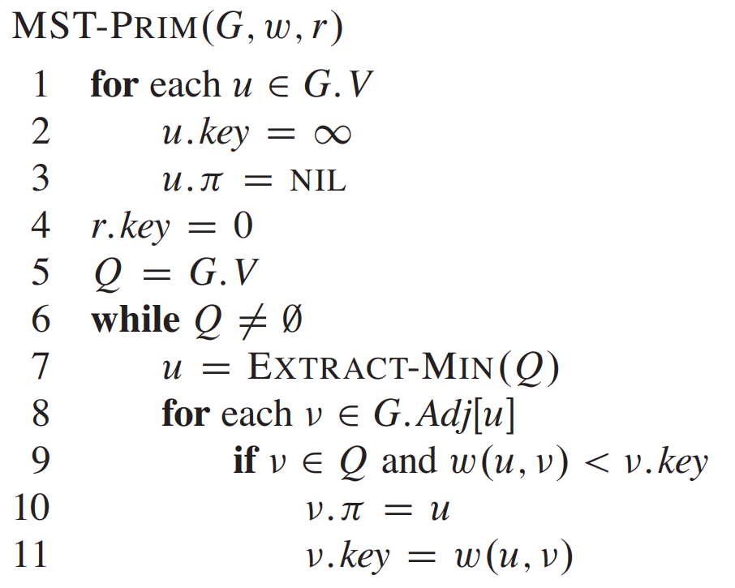
Prim’s Algorithm – Simulation and Psuedocode

Slide 10
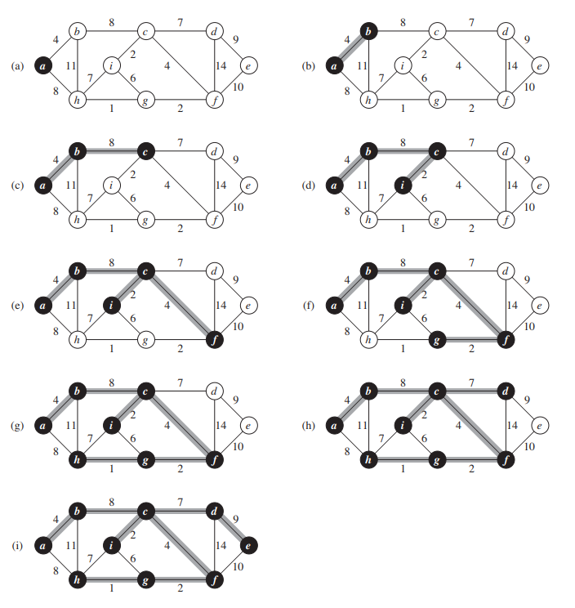
Prim’s Algorithm – Simulation and Psuedocode

Slide 11
Prim’s Algorithm
MST-Prim(G, w, r)
Q = V[G];
for each u ∈ Q
key[u] = ∞;
key[r] = 0;
p[r] = NULL;
while (Q not empty)
u = ExtractMin(Q);
for each v ∈ Adj[u]
if (v ∈ Q and w(u,v) < key[v])
p[v] = u;
key[v] = w(u,v);
6
4
5
9
14
2
10
15
3
8
Run on example graph

Slide 12
Prim’s Algorithm
MST-Prim(G, w, r)
Q = V[G];
for each u ∈ Q
key[u] = ∞;
key[r] = 0;
p[r] = NULL;
while (Q not empty)
u = ExtractMin(Q);
for each v ∈ Adj[u]
if (v ∈ Q and w(u,v) < key[v])
p[v] = u;
key[v] = w(u,v);
6
∞
4
5
9
∞
∞
∞
14
2
10
15
∞
∞
∞
3
∞
8
Run on example graph

Slide 13
Prim’s Algorithm
f
MST-Prim(G, w, r)
Q = V[G];
for each u ∈ Q
key[u] = ∞;
key[r] = 0;
p[r] = NULL;
while (Q not empty)
u = ExtractMin(Q);
for each v ∈ Adj[u]
if (v ∈ Q and w(u,v) < key[v])
p[v] = u;
key[v] = w(u,v);
g
6
4
4
5
2
9
5
9
d
e
14
10
2
r
15
r
0
8
15
3
8
b
c
3
a
 | r | a | b | c | d | e | f | g
 | 0 | inf | inf | inf | inf | inf | inf | inf
r | x | 3,r | inf | inf | inf | inf | inf | 14,r
a(3,r) | x | x | 8,a | inf | inf | inf | inf | 10,a
b(8,a) | x | x | x | 15,b | 2,b | inf | inf | 10,a
d(2,b) | x | x | x | 15,b | x | 9,d | 4,d | 5,d
f(4,d) | x | x | x | 15,b | x | 9,d | X | 5,d
g(5,d) | x | x | x | 15,b | x | 9,d | X | x
e(9,d) | x | x | x | 15,b | x | x | x | x
c(15,b) | x | x | x | x | x | x | x | x
5+4+2+9+3+8+15=46

Slide 14
Prim’s Algorithm – Time Complexity
O(V)
O(1)
O(V)
O(V)
O(V)
O(logV)
O(E)
O(E)
O(logV)

Slide 15
Things You Will Learn
What is a spanning tree?
What is a minimum spanning tree (MST)?
Optimal Substructure Property in the MST problem
Prim’s Algorithm
Simulation
Algorithm
Cost Analysis
Kruskal’s Algorithm
Simulation
Algorithm
Cost Analysis

Slide 16
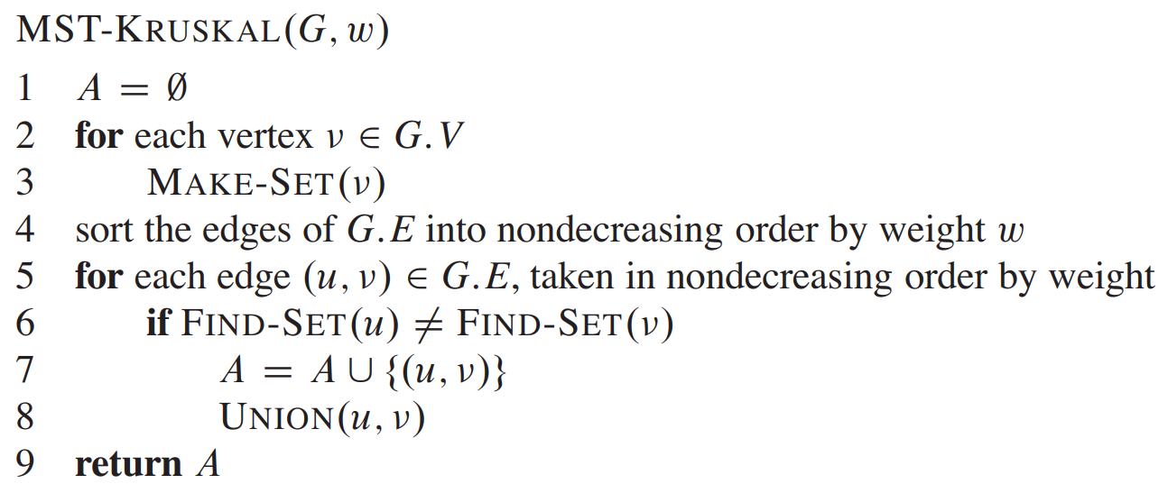
Kruskal’s Algorithm- Simulation and Pseudocode

Slide 17
Kruskal’s Algorithm
2
19
9
14
17
8
25
5
Kruskal()
{
T = ∅;
for each v ∈ V
MakeSet(v);
sort E into nondecreasing order by weight w
for each (u,v) ∈ E (in sorted order)
if FindSet(u) ≠ FindSet(v)
T = T U {{u,v}};
Union(u,v);
}
21
13
1

Slide 18
Kruskal’s Algorithm
2
19
9
14
17
8
25
5
Kruskal()
{
T = ∅;
for each v ∈ V
MakeSet(v);
sort E into nondecreasing order by weight w
for each (u,v) ∈ E (in sorted order)
if FindSet(u) ≠ FindSet(v)
T = T U {{u,v}};
Union(u,v);
}
21
13
1

Slide 19
Kruskal’s Algorithm
2
19
9
14
17
8
25
5
Kruskal()
{
T = ∅;
for each v ∈ V
MakeSet(v);
sort E into nondecreasing order by weight w
for each (u,v) ∈ E (in sorted order)
if FindSet(u) ≠ FindSet(v)
T = T U {{u,v}};
Union(u,v);
}
21
13
1

Slide 20
Kruskal’s Algorithm
2
19
9
14
17
8
25
5
Kruskal()
{
T = ∅;
for each v ∈ V
MakeSet(v);
sort E into nondecreasing order by weight w
for each (u,v) ∈ E (in sorted order)
if FindSet(u) ≠ FindSet(v)
T = T U {{u,v}};
Union(u,v);
}
21
13
1?

Slide 21
Kruskal’s Algorithm
2
19
9
14
17
8
25
5
Kruskal()
{
T = ∅;
for each v ∈ V
MakeSet(v);
sort E into nondecreasing order by weight w
for each (u,v) ∈ E (in sorted order)
if FindSet(u) ≠ FindSet(v)
T = T U {{u,v}};
Union(u,v);
}
21
13
1

Slide 22
Kruskal’s Algorithm
2?
19
9
14
17
8
25
5
Kruskal()
{
T = ∅;
for each v ∈ V
MakeSet(v);
sort E into nondecreasing order by weight w
for each (u,v) ∈ E (in sorted order)
if FindSet(u) ≠ FindSet(v)
T = T U {{u,v}};
Union(u,v);
}
21
13
1

Slide 23
Kruskal’s Algorithm
2
19
9
14
17
8
25
5
Kruskal()
{
T = ∅;
for each v ∈ V
MakeSet(v);
sort E into nondecreasing order by weight w
for each (u,v) ∈ E (in sorted order)
if FindSet(u) ≠ FindSet(v)
T = T U {{u,v}};
Union(u,v);
}
21
13
1

Slide 24
Kruskal’s Algorithm
2
19
9
14
17
8
25
5?
Kruskal()
{
T = ∅;
for each v ∈ V
MakeSet(v);
sort E into nondecreasing order by weight w
for each (u,v) ∈ E (in sorted order)
if FindSet(u) ≠ FindSet(v)
T = T U {{u,v}};
Union(u,v);
}
21
13
1

Slide 25
Kruskal’s Algorithm
2
19
9
14
17
8
25
5
Kruskal()
{
T = ∅;
for each v ∈ V
MakeSet(v);
sort E into nondecreasing order by weight w
for each (u,v) ∈ E (in sorted order)
if FindSet(u) ≠ FindSet(v)
T = T U {{u,v}};
Union(u,v);
}
21
13
1

Slide 26
Kruskal’s Algorithm
2
19
9
14
17
8?
25
5
Kruskal()
{
T = ∅;
for each v ∈ V
MakeSet(v);
sort E into nondecreasing order by weight w
for each (u,v) ∈ E (in sorted order)
if FindSet(u) ≠ FindSet(v)
T = T U {{u,v}};
Union(u,v);
}
21
13
1

Slide 27
Kruskal’s Algorithm
2
19
9
14
17
8
25
5
Kruskal()
{
T = ∅;
for each v ∈ V
MakeSet(v);
sort E into nondecreasing order by weight w
for each (u,v) ∈ E (in sorted order)
if FindSet(u) ≠ FindSet(v)
T = T U {{u,v}};
Union(u,v);
}
21
13
1

Slide 28
Kruskal’s Algorithm
2
19
9?
14
17
8
25
5
Kruskal()
{
T = ∅;
for each v ∈ V
MakeSet(v);
sort E into nondecreasing order by weight w
for each (u,v) ∈ E (in sorted order)
if FindSet(u) ≠ FindSet(v)
T = T U {{u,v}};
Union(u,v);
}
21
13
1

Slide 29
Kruskal’s Algorithm
2
19
9
14
17
8
25
5
Kruskal()
{
T = ∅;
for each v ∈ V
MakeSet(v);
sort E into nondecreasing order by weight w
for each (u,v) ∈ E (in sorted order)
if FindSet(u) ≠ FindSet(v)
T = T U {{u,v}};
Union(u,v);
}
21
13
1

Slide 30
Kruskal’s Algorithm
2
19
9
14
17
8
25
5
Kruskal()
{
T = ∅;
for each v ∈ V
MakeSet(v);
sort E into nondecreasing order by weight w
for each (u,v) ∈ E (in sorted order)
if FindSet(u) ≠ FindSet(v)
T = T U {{u,v}};
Union(u,v);
}
21
13?
1

Slide 31
Kruskal’s Algorithm
2
19
9
14
17
8
25
5
Kruskal()
{
T = ∅;
for each v ∈ V
MakeSet(v);
sort E into nondecreasing order by weight w
for each (u,v) ∈ E (in sorted order)
if FindSet(u) ≠ FindSet(v)
T = T U {{u,v}};
Union(u,v);
}
21
13
1

Slide 32
Kruskal’s Algorithm
2
19
9
14?
17
8
25
5
Kruskal()
{
T = ∅;
for each v ∈ V
MakeSet(v);
sort E into nondecreasing order by weight w
for each (u,v) ∈ E (in sorted order)
if FindSet(u) ≠ FindSet(v)
T = T U {{u,v}};
Union(u,v);
}
21
13
1

Slide 33
Kruskal’s Algorithm
2
19
9
14
17
8
25
5
Kruskal()
{
T = ∅;
for each v ∈ V
MakeSet(v);
sort E into nondecreasing order by weight w
for each (u,v) ∈ E (in sorted order)
if FindSet(u) ≠ FindSet(v)
T = T U {{u,v}};
Union(u,v);
}
21
13
1

Slide 34
Kruskal’s Algorithm
2
19
9
14
17?
8
25
5
Kruskal()
{
T = ∅;
for each v ∈ V
MakeSet(v);
sort E into nondecreasing order by weight w
for each (u,v) ∈ E (in sorted order)
if FindSet(u) ≠ FindSet(v)
T = T U {{u,v}};
Union(u,v);
}
21
13
1

Slide 35
Kruskal’s Algorithm
2
19?
9
14
17
8
25
5
Kruskal()
{
T = ∅;
for each v ∈ V
MakeSet(v);
sort E into nondecreasing order by weight w
for each (u,v) ∈ E (in sorted order)
if FindSet(u) ≠ FindSet(v)
T = T U {{u,v}};
Union(u,v);
}
21
13
1

Slide 36
Kruskal’s Algorithm
2
19
9
14
17
8
25
5
Kruskal()
{
T = ∅;
for each v ∈ V
MakeSet(v);
sort E into nondecreasing order by weight w
for each (u,v) ∈ E (in sorted order)
if FindSet(u) ≠ FindSet(v)
T = T U {{u,v}};
Union(u,v);
}
21?
13
1

Slide 37
Kruskal’s Algorithm
2
19
9
14
17
8
25?
5
Kruskal()
{
T = ∅;
for each v ∈ V
MakeSet(v);
sort E into nondecreasing order by weight w
for each (u,v) ∈ E (in sorted order)
if FindSet(u) ≠ FindSet(v)
T = T U {{u,v}};
Union(u,v);
}
21
13
1

Slide 38
Kruskal’s Algorithm
2
19
9
14
17
8
25
5
Kruskal()
{
T = ∅;
for each v ∈ V
MakeSet(v);
sort E into nondecreasing order by weight w
for each (u,v) ∈ E (in sorted order)
if FindSet(u) ≠ FindSet(v)
T = T U {{u,v}};
Union(u,v);
}
21
13
1

Slide 39
Kruskal’s Algorithm
2
19
9
14
17
8
25
5
Kruskal()
{
T = ∅;
for each v ∈ V
MakeSet(v);
sort E into nondecreasing order by weight w
for each (u,v) ∈ E (in sorted order)
if FindSet(u) ≠ FindSet(v)
T = T U {{u,v}};
Union(u,v);
}
21
13
1

Slide 40

Kruskal’s Algorithm-Time Complexity
O(1)
O(V)
O(V)
*Time for MakeSet()
O(ElogE)
O(E)
O(E)*Time for Find Set
O(E)
O(E) * Time for Union

Slide 41
Kruskal’s Algorithm-Time Complexity
To summarize:
Sort edges: O(E lg E)
O(V) MakeSet()’s - O(1)
O(E) FindSet()’s - O(α(V)) – α – Ackerman’s function – almost a constant value
O(V) Union()’s - O(α(V)) – α – Ackerman’s function – almost a constant value
Upshot:
It is dominated by the sorting as α(V) almost stays a constant
Thus overall time is O(E lg E) = O(E lg V), since |E| can be near to |V|² in a complete graph

Slide 42
Thank You

